Slide 1



Open Source Community
CLI

Slide 2

Agenda;
-The shell
-The terminal
-Linux filesystem Hierarchy
-. and ..
-Relative and absolute path

Slide 3

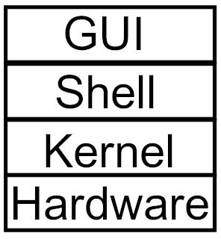
The Shell
The shell is command interpreter
To open it press CTRL+ALT+any function key 2-7 , you may need to press fn key

Slide 4
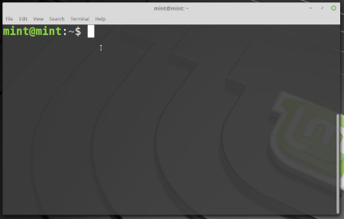
Terminal
More convenient way to connect to the shell
Keyboard shortcut for it is CTRL+ALT+T or just right click and choose open terminal

Slide 5

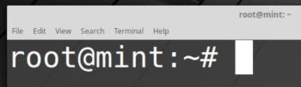
Command line prompt
By default the command line prompt is like this
username → osc
@ → Defines that you are connected to the machine next to it
mint → machine name that you are connected to (host name)
~ → the working directory
$ → for user (changes to # if you are the root)
username@hostname:working_directory($/#)

Slide 6

Command line syntax
command → The order you want to do
option → modifies the action of the command (optional) and we can combine more than one option
argument → what you are going to apply the command to

Slide 7
Commands
ls → lists the content of a directory
ls -l → gives more details for each file/directory like the date and permissions
ls -a → prints all files including hidden ones
ls -la OR ls -l -a → prints all files including hidden ones with more details
pwd → prints the current working directory
cd → changes the current working directory

Slide 8
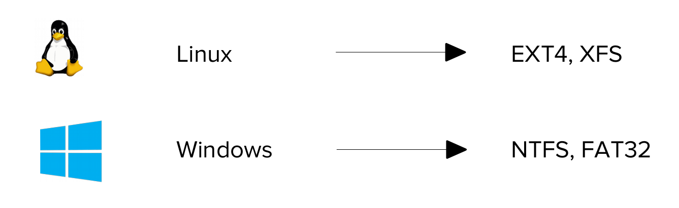
Filesystem
It is the way the files are stored in a storage device
it is different according to the operating system
Note : Linux supports NTFS and FAT32 but Windows doesn’t support EXT4 or XFS that’s why we can’t see Linux partitions on windows

Slide 9
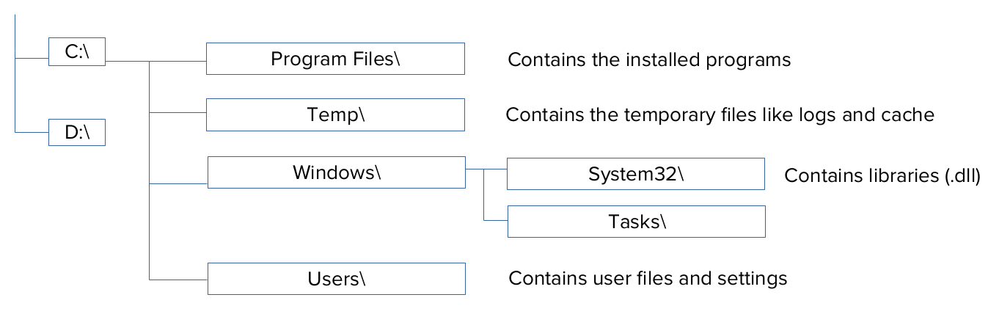
Windows Directory structure

Slide 10
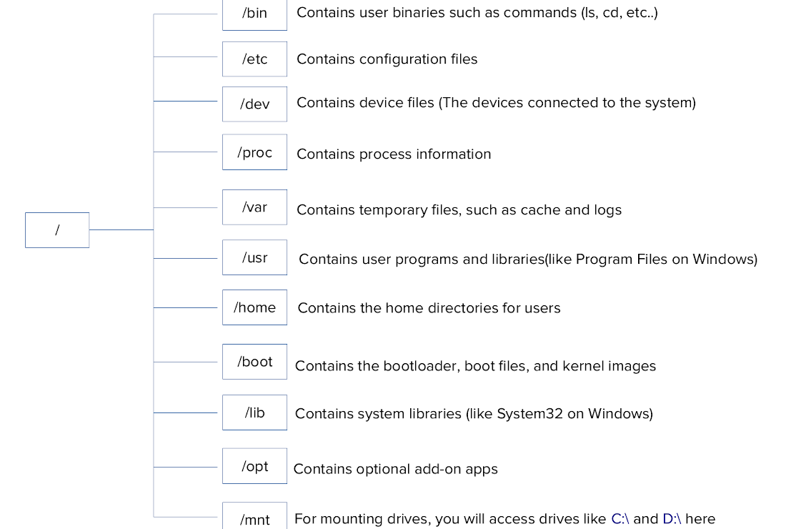

Slide 11
Linux filesystem hierarchy
From the previous we can see that everything in linux is a file even devices and processes
Note: C:\ and D:\ here are not accessed as C:\ or D:\, but instead as directories under ‘/’

Slide 12
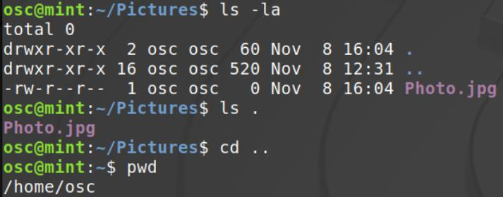
The . and ..
. → refers to the directory itself
.. → refers to the parent directory
ex : pwd → /home/osc/Pictures
then . refers to /home/osc/Pictures and .. refers to /home/osc

Slide 13
Relative and absolute path
Relative path → is a path relative to the working directory
Absolute path → is the total path leading to the directory (starting from the root to the directory)
ex : if the current working directory is home (/home/osc) and you want to go to Pictures
relative path : cd Pictures
absolute path : cd /home/osc/Pictures

Slide 14

Thank you

